Slide 1
IoT-based Manhole Detection and Monitoring System

Slide 2
PROBLEM STATEMENT
Manhole detection and monitoring is an essential requirement for modern society, particularly smart city planning.
The concept of this project arises from the belief that missing or stolen manholes cause various road accidents and reduce the quality of the city.
Man had to go inside the drainage system to clean the garbage in the previous system, but the new system has made the work easier and safer by reducing those things.
Manhole detection and monitoring system based on IoT is a very useful system for all of us because it detects manhole conditions.
Here, we used the different components like water flow sensor, gas sensor, temperature and humidity sensor
In our manhole detection and monitoring system project we have to detect the flow of water, and toxic gases, sense the humidity and temperature in the manhole and it sends an IOT message.
In this system we have also reduced the work of manpower and easy to handle the situation.

Slide 3
PROPOSED SYSTEM
Nowadays, accidents due to broken and missing manhole covers are quite frequent. Manholes are not monitored properly in developing countries. These accidents can lead to serious injuries and also death.
Hence, here we propose a system to overcome this problem. We have included an array of sensors for complete monitoring of the manhole cover so that such accidents can be prevented.
This project includes a gas cover to monitor the gas emitted from the sewage systems so that toxicity can be monitored, the internal temperature is also monitored if a check for a change in the temperature as the property of manhole changes with temperature which could need to crack formation, a tilt sensor is introduced to indicate whether the manhole can tilt.
Also, a float sensor is used to indicate when the water level goes beyond a certain level, in case of any alert due to any of the parameters we send an SMS to an authority number as well as on the IoT website.
Also, all the parameters are continuously updated on the website.

Slide 4






PROJECT DEVELOPMENT STAGES
Programming
Component Mapping & Soldering
PCB Printing & Connectivity Testing
Components Procurement
Circuit Design
Choosing Microcontroller

Slide 5
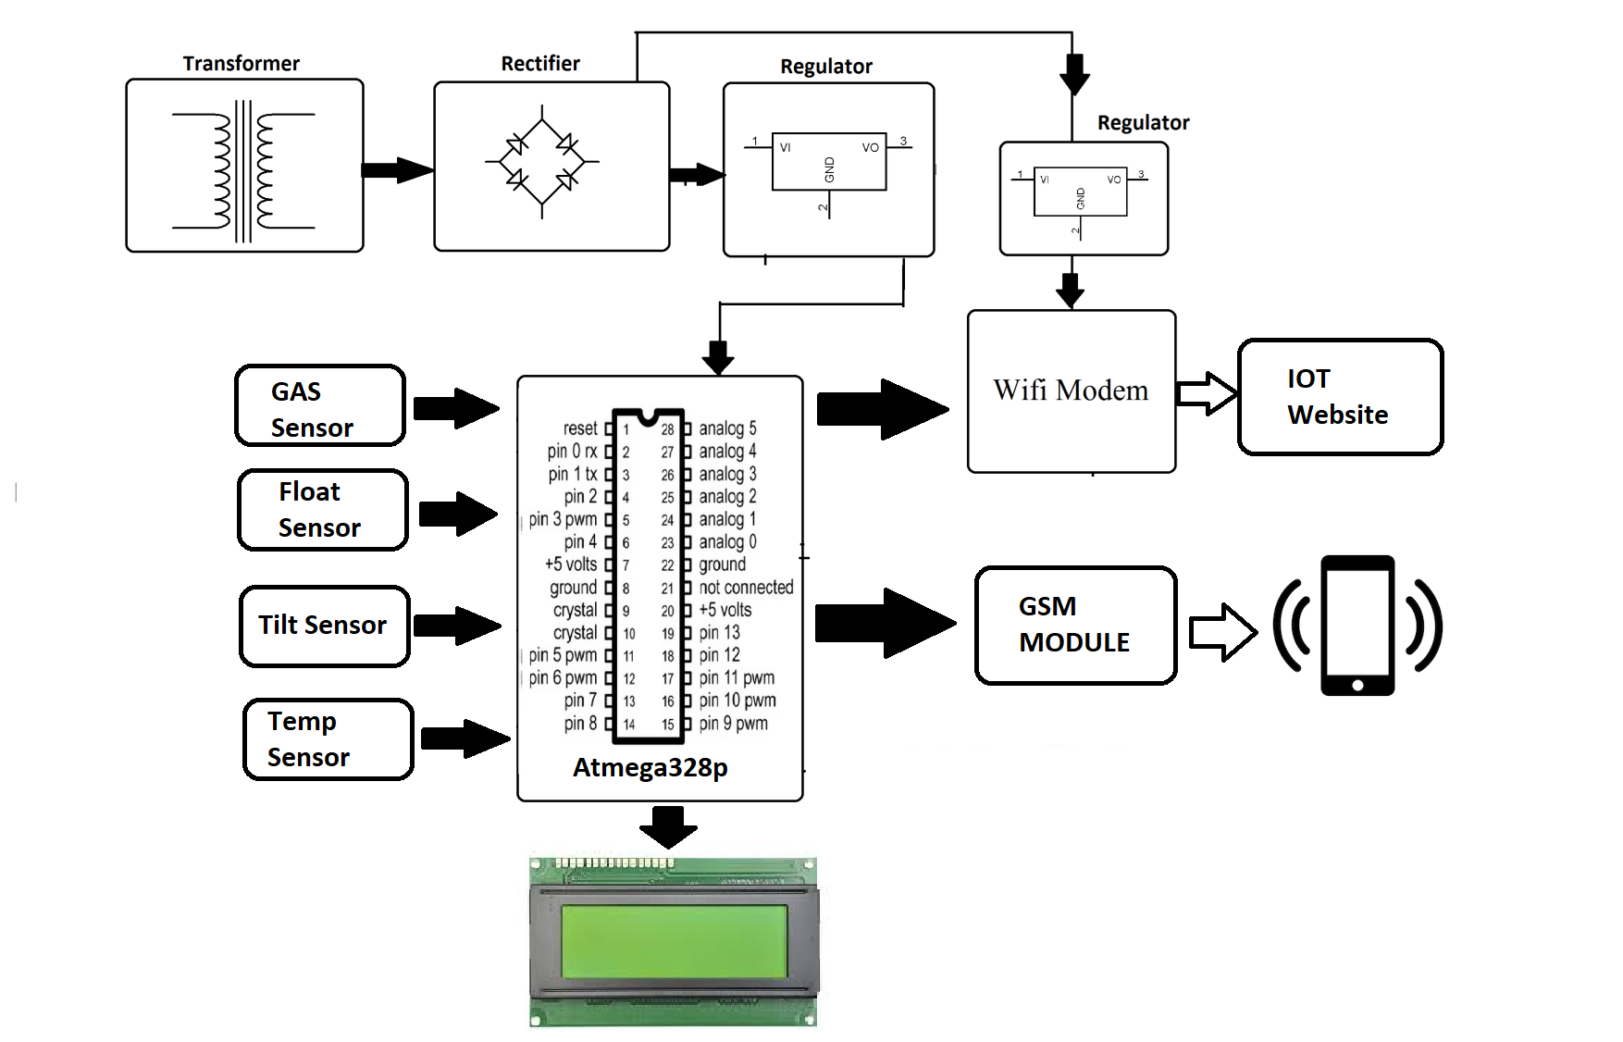
BLOCK DIAGRAM

Slide 6
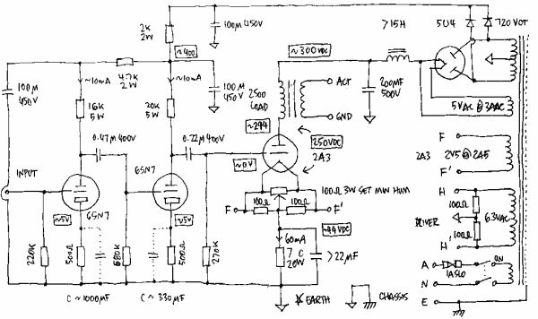
CIRCUIT DESIGN
A circuit is actually any loop through which matter is carried. For an electronic circuit, the matter carried is the charge by electronics and the source of these electrons is the positive terminal of the voltage source .When this charge flows from the positive terminal, through out the loop and reaches the negative terminal, the circuit is said to be completed. However this circuit consists of a number of components which affects the flow of charge in many ways. Some may provide hindrance to the flow of charge, some simple store or dissipate charge. Some require external source of energy, some supply energy.
Circuit Design Tools:
Eagle, Kicad, Proteus
Circuit Digest Capacitor Calculator
Nevon Express Resistor Color Code Calculator

Slide 7
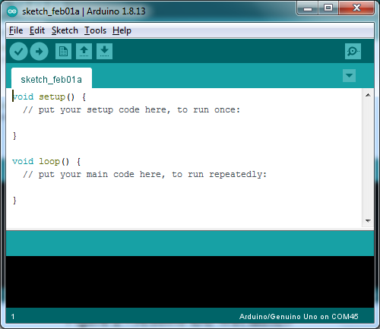
PROGRAMMING
A code editor is also called an integrated development environment, or IDE. An IDE is a software application for formatting your code, checking syntax, as well as running and testing your code. Some IDEs can work with multiple programming languages, while some are very specific for only one language. The Arduino Integrated Development Environment (IDE) is the main text editing program used for Arduino programming. It is where you’ll be typing up your code before uploading it to the board you want to program. Arduino code is referred to as sketches.

Slide 8

WHAT LANGUAGE IS ARDUINO ?
Arduino code is written in C++ with an addition of special methods and functions, which we’ll mention later on. C++ is a human-readable programming language. When you create a ‘sketch’ (the name given to Arduino code files), it is processed and compiled to machine language. Arduino programming language can be divided in three main parts:
Functions
Values (variables and constants)
Structure.

Slide 9
HARDWARE & SOFTWARE REQUIREMENTS
Hardware Specifications
Atmega328P
Gas Sensor
Tilt Sensor
Temperature Sensor
Float Sensor
Crystal Oscillator
Resistors
Capacitors
Transistors
Cables and Connectors
Diodes
Software Specifications
Arduino Compiler
MC Programming Language: C
PCB and Breadboards
LED
Transformer/Adapter
Push Buttons
Switch
IC
IC Sockets

Slide 10
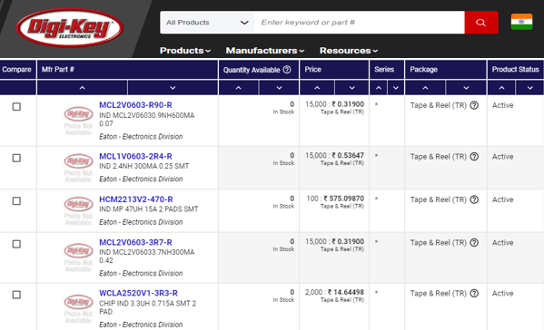
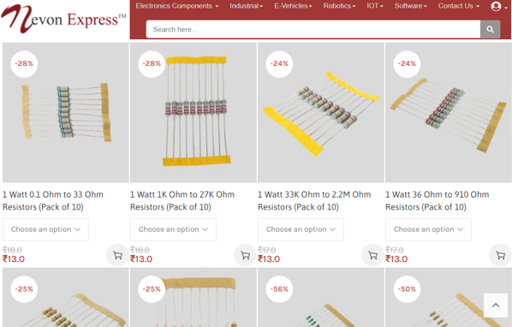
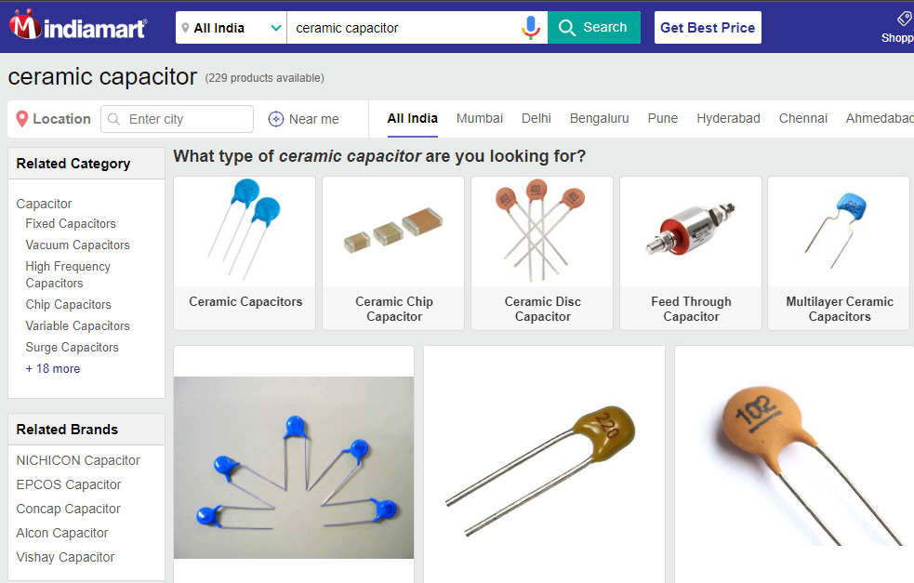
Basic Electronics Components
Basic Electronic Components are: resistor, capacitor, transistor, diode, operational amplifier, resistor array, logic gate etc. These are of 2 types: Passive and Active Components. Both these types of components can be either Through-Hole or SMD. One can buy these components easily online from websites like www.nevonexpress.in, www.digikey.in, www.indiamart.com,etc.

Slide 11
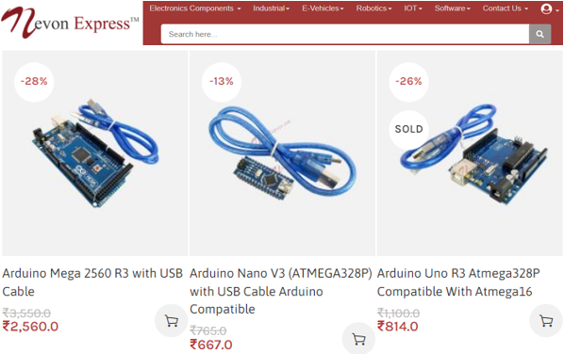
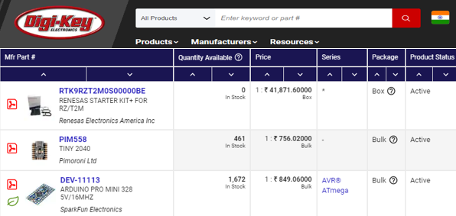
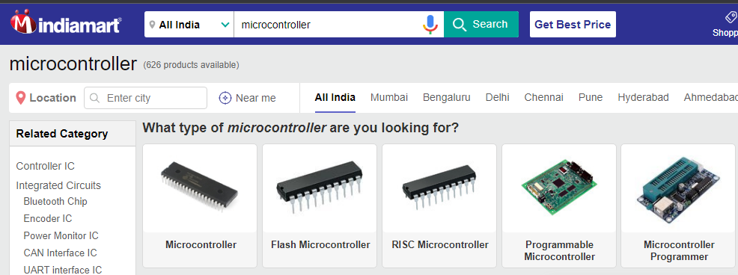
Microcontrollers & Development Boards
A microcontroller is a compact integrated circuit designed to govern a specific operation in an embedded system. A typical microcontroller includes a processor, memory and input/output (I/O) peripherals on a single chip. A development board is a printed circuit board with circuitry and hardware designed to facilitate experimentation with a certain microcontroller. Also there are certain hardware circuits that greatly aid testing and debugging such as pushbuttons and LEDs. One can buy these components easily online from websites like www.nevonexpress.in, www.digikey.in, www.indiamart.com,etc.

Slide 12
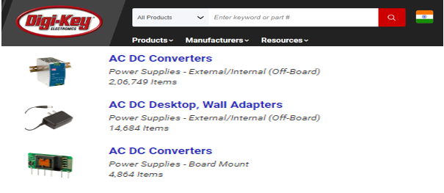
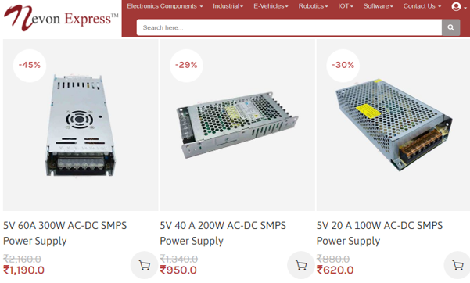
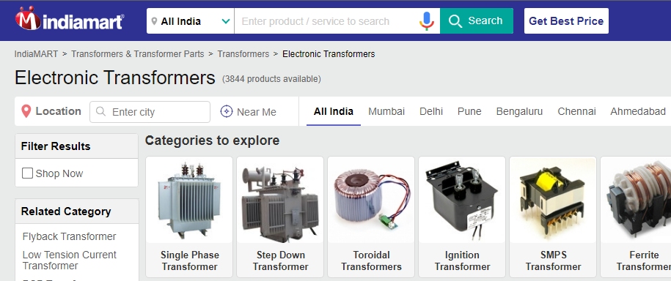
Transformers & Power Supply
A power supply is an electrical device that supplies electric power to an electrical load. The main purpose of a power supply is to convert electric current from a source to the correct voltage, current, and frequency to power the load. One can buy them easily online from websites like www.nevonexpress.in, www.digikey.in, www.indiamart.com,etc.

Slide 13
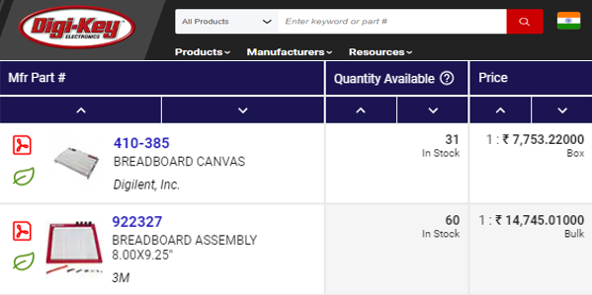
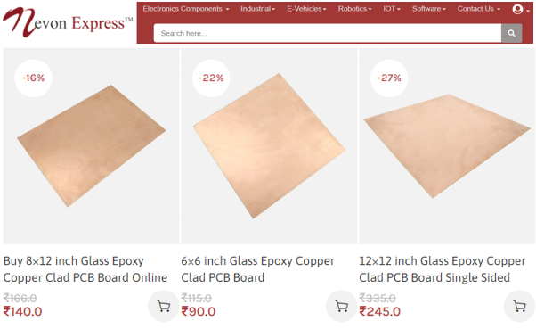
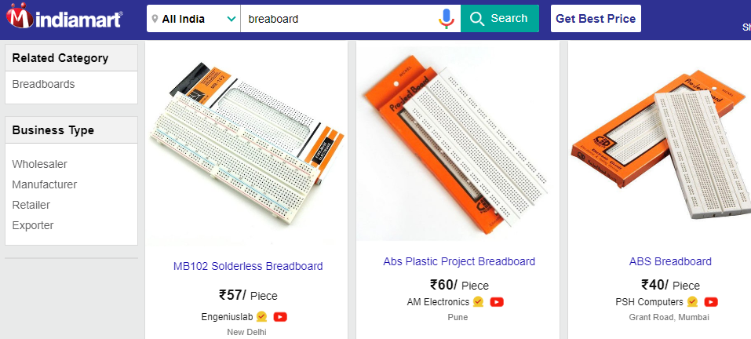
PCB & Breadboards
A printed circuit board (PCB) is a laminated sandwich structure of conductive and insulating layers. One can buy them easily online from websites like www.nevonexpress.in, www.digikey.in, www.indiamart.com,etc.

Slide 14
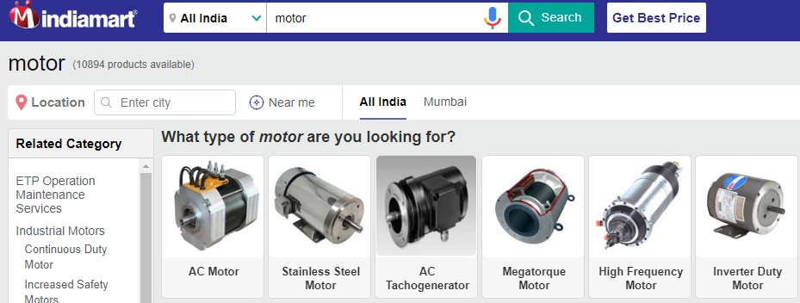
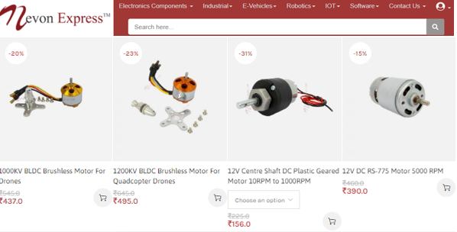
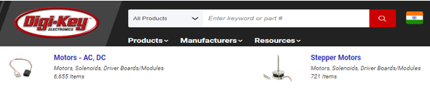
Motors
The word "motor" refers to any power unit that generates motion, that is a "prime mover", while "electric motor" refers to a "prime mover using electricity.“ An electric motor is a device used to convert electrical energy into mechanical energy. One can buy them easily online from websites like www.nevonexpress.in, www.digikey.in, www.indiamart.com,etc.

Slide 15
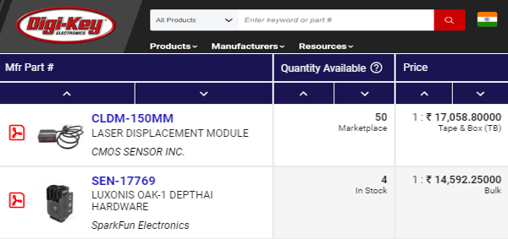
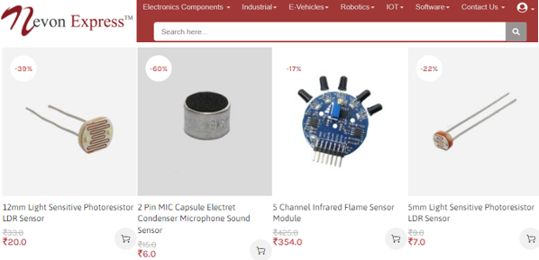
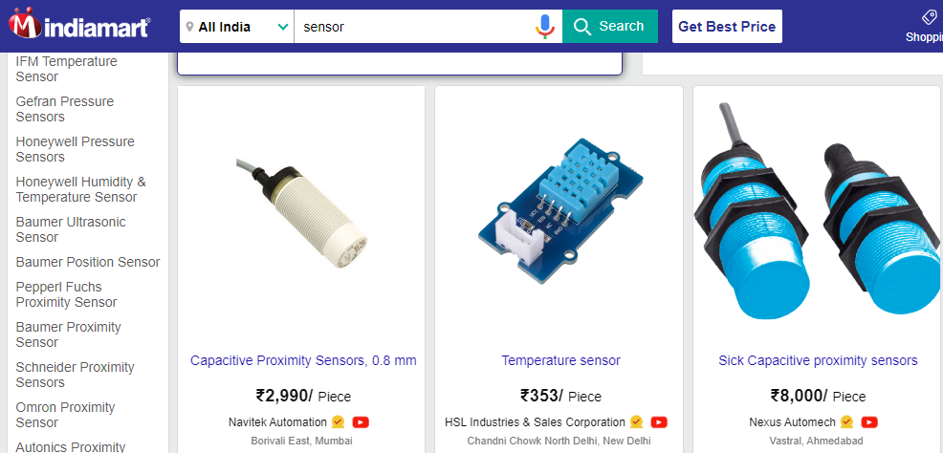
Sensors & Modules
Sensors and modules (having extra electronic circuitry along with sensor) are Electronic devices that detect and respond to some type of input from the physical environment. One can buy them easily online from websites like www.nevonexpress.in, www.digikey.in, www.indiamart.com,etc.

Slide 16
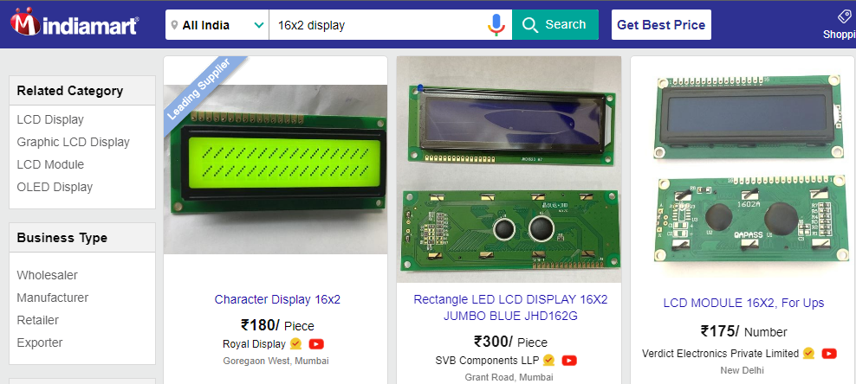
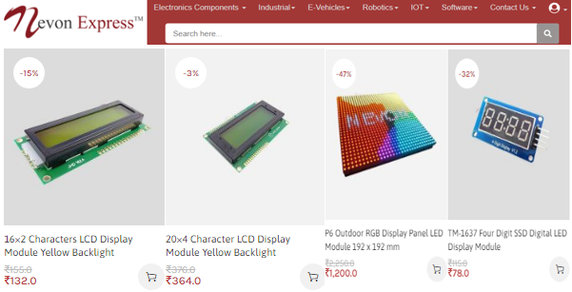
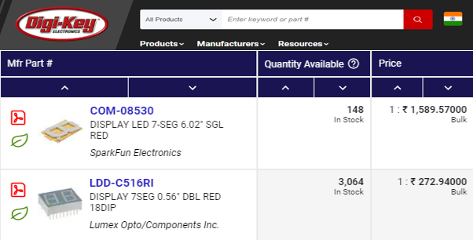
LED/LCD Displays
An LCD (Liquid Crystal Display) screen is an electronic display module and has a wide range of applications. A 16x2 LCD display is very basic module and is very commonly used in various devices and circuits. One can buy them easily online from websites like www.nevonexpress.in, www.digikey.in, www.indiamart.com,etc.

Slide 17
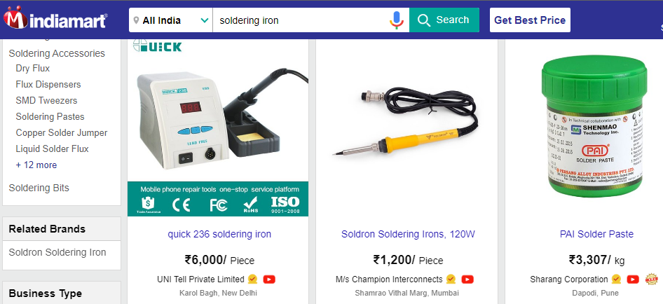
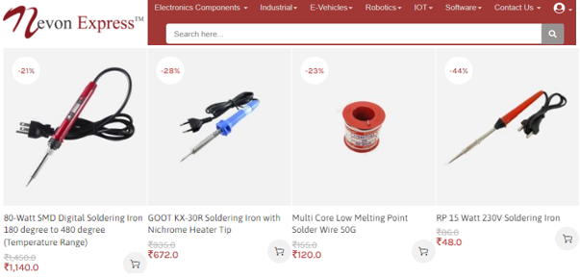
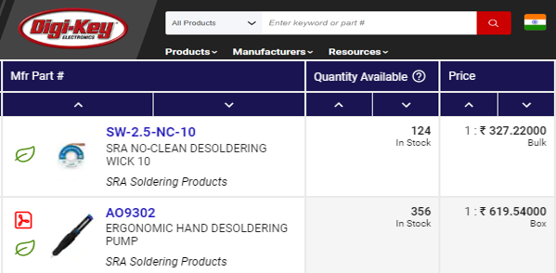
Soldering Iron & Accessories
Soldering is a process used for joining metal parts to form a mechanical or electrical bond. One can buy them easily online from websites like www.nevonexpress.in, www.digikey.in, www.indiamart.com,etc.

Slide 18
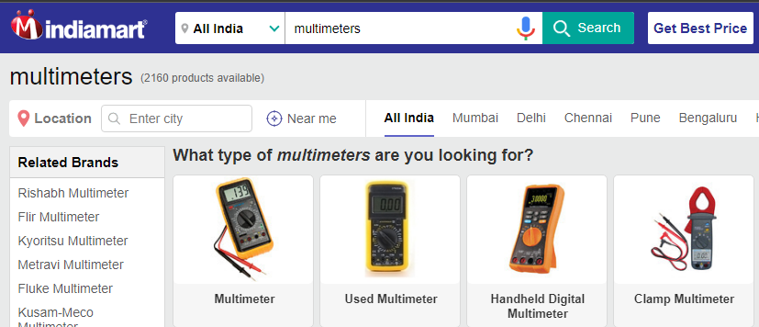
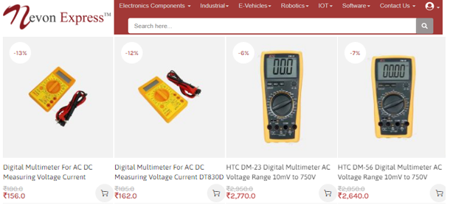
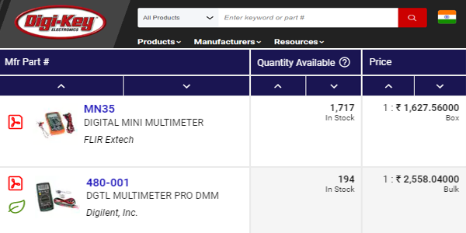
Testing & Troubleshooting Equipment
Multimeters are the most versatile of the electrical testers and, as the name implies, they are capable of many different testing functions. One can buy them easily online from websites like www.nevonexpress.in, www.digikey.in, www.indiamart.com,etc

Slide 19
CONCLUSION
IoT-based manhole detection and monitoring system It is a very useful system for all of us because it detects and monitors manhole situations.
In the system, various components such as the Arduino UNO, DHT11 sensor, MQ4 gas sensor flow sensor, Wi-Fi module and ESP8266 LCD display were used.
In this system, we used different sensors; if a problem occurs in the band holder, the sensor sends the information to the microcontroller, and the microcontroller gives the information to the Wi-Fi module, which sends the information to the authorized person.

Slide 20
REFERENCES
https://ieeexplore.ieee.org/document/9793287
https://www.ijert.org/research/manhole-detection-and-monitoring-system-IJERTCONV9IS12005.pdf
https://www.researchgate.net/publication/352167430_Manhole_cover_monitoring_system_over_IOT
https://ijrpr.com/uploads/V2ISSUE9/IJRPR1239.pdf

Slide 21
THANKYOU

